Slide 1


theknowledgeacademy
Public Speaking Course

Slide 2


theknowledgeacademy
The world's largest provider of classroom and online training courses
About Us
World Class Training Solutions
Subject Matter Experts
Highest Quality Training Material
Accelerated Learning Techniques
Project, Programme, and Change Management, ITIL® Consultancy
Bespoke Tailor Made Training Solutions
PRINCE2®, MSP®, ITIL®, Soft Skills, and More

Slide 3

theknowledgeacademy
Course Syllabus
Module 1: Introduction to Public Speaking
4
Module 2: Getting Your Point Across
16
Module 3: Controlling the Unexpected
40
Module 4: Techniques of a Good Public Speaker
53
Module 5: Enhancing Your Presentation Skills
53

Slide 4

theknowledgeacademy
Module 1:
Introduction
Facing the Fear of Public Speaking
Introduction to Public Speaking
The Who, What and How of Speaking Successfully

Slide 5


Introduction
Public speaking is the art of delivering a speech or presentation to an audience.
It can be an effective tool for communicating ideas, sharing knowledge, inspiring people, and influencing opinions.
Public speaking is a valuable skill that can be used in a variety of settings, including business, politics, education, and social events.
To be an effective public speaker, it's important to have a clear message, engaging delivery, and an understanding of your audience.
This involves carefully selecting your topic, organising your ideas, practising your delivery, and considering the needs and interests of your audience.
theknowledgeacademy

Slide 6

Quiz
Question 2: Which of the following is a key strategy for avoiding cross infection in the workplace?
A) Reducing the number of employees in the workplace. B) Implementing strict handwashing protocols and use of personal protective equipment (PPE). C) Decreasing the frequency of health and safety training. D) Limiting the use of surface disinfectants.
theknowledgeacademy

Slide 7


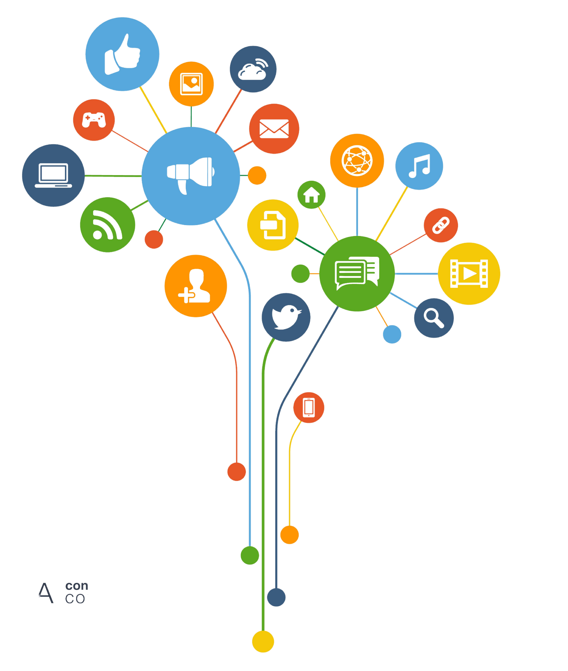




The World’s Largest Global Training Provider
theknowledgeacademy.com
info@theknowledgeacademy.com
/The.Knowledge.Academy.Ltd
/TKA_Training
/the-knowledge-academy
Congratulations
/TheKnowledgeAcademy

